Slide 1
ImageNet-trained CNNs are biased towards texture; increasing shape bias improves accuracy and robustness Robert Geirhos, Claudio Michaelis, Patricia Rubisch, Felix A. Wichmann, Matthias Bethge, Wieland Brendel mainly University of Tübingen (& IMPRIS-IS)
Fabrice Beaumont Rheinische Friedrich-Wilhelms-Universität Bonn
30.09.2020

Slide 2
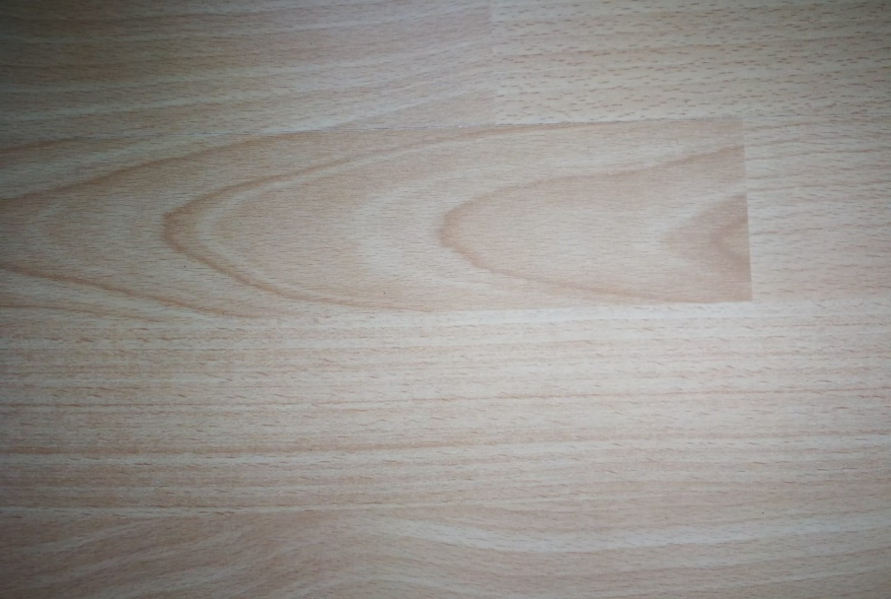
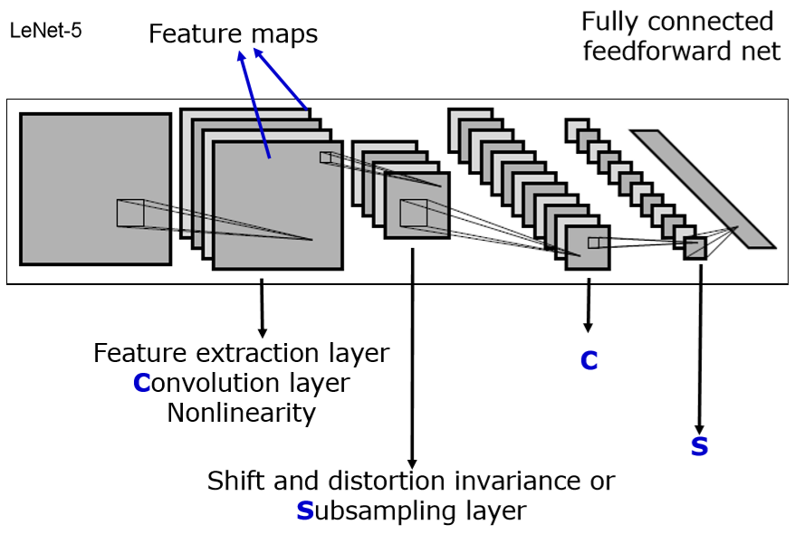

ImageNet-trained CNNs are biased towards texture; increasing shape bias improves accuracy and robustness )
1995 by Yann LeCun and Yoshua Bengio
DEF: feature = sth. learned by CNN, cue = a physical feature
TODO: Image by lecture TNN of Dr. Nils Goerke, University of Bonn, 1/2020

Slide 3
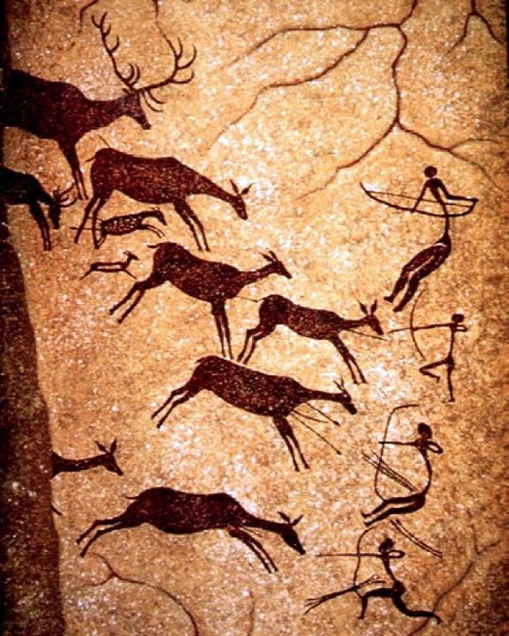
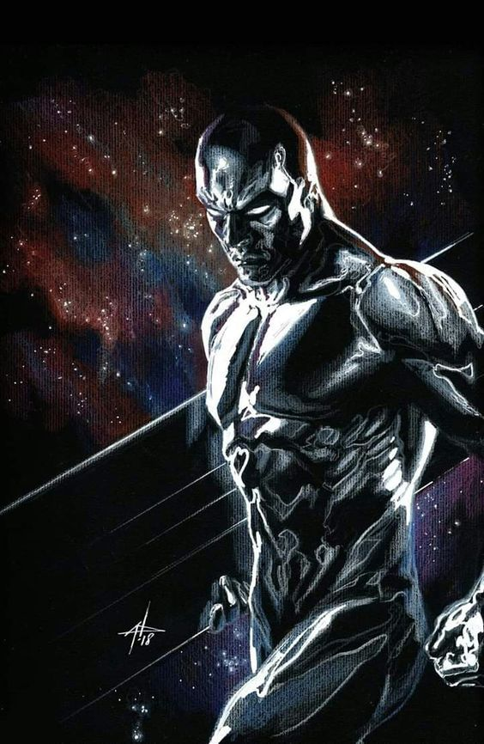
Motivation Importance of shape for object recognition
1 / 26
https://www.pinterest.es/pin/479703797791622080/
https://www.pinterest.at/pin/189080884344850413/

Slide 4
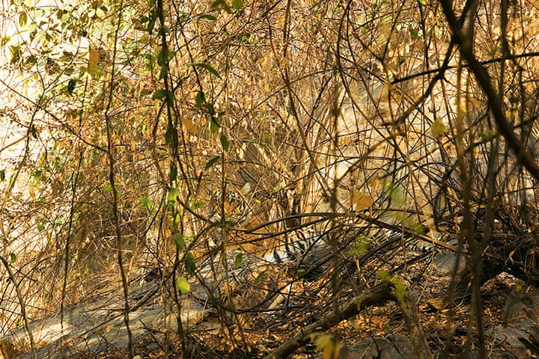
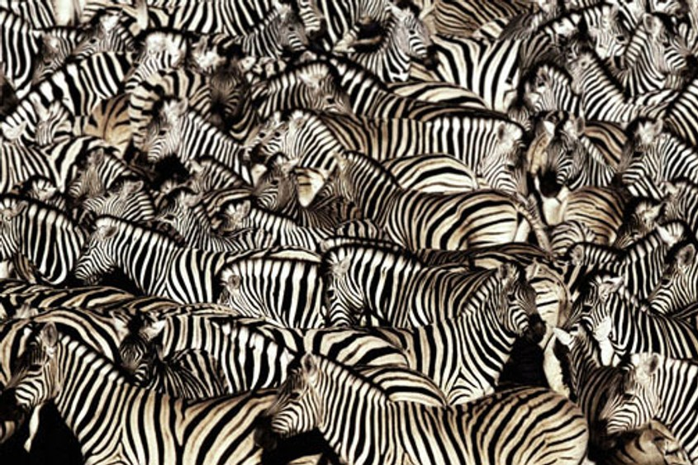
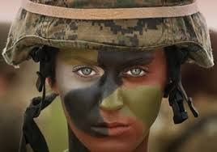
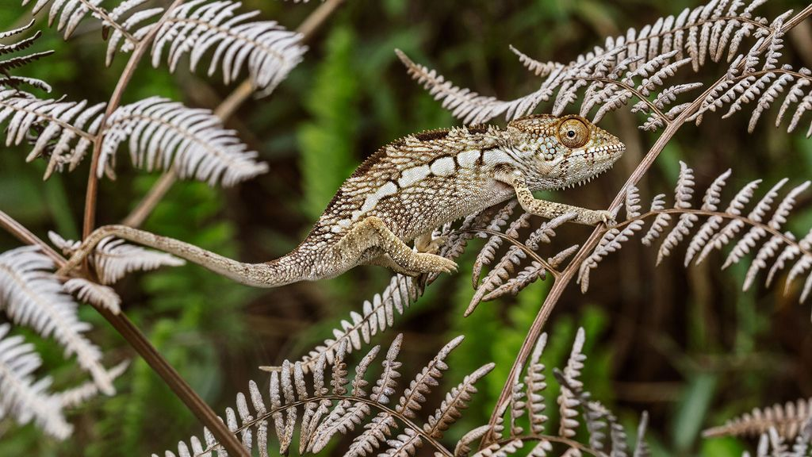
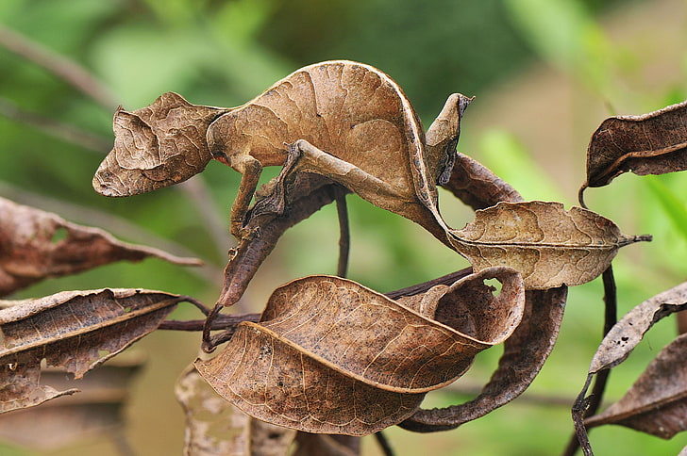
Motivation Importance of shape for object recognition
1 / 26
https://www.socialsciencespace.com/wp-content/uploads/Disguise-Zebra-Africa-Animal-Camouflage-2691945_opt.jpg
https://www.economist.com/img/b/1000/563/90/sites/default/files/images/print-edition/20120211_STP002_0.jpg
https://www.pinterest.de/pin/373446994099169156/
https://www.nationalgeographic.de/tiere/2018/08/chamaeleons-verrueckteste-farbwechsel-dienen-nicht-der-tarnung
https://i.redd.it/gmvyk1pz26p21.jpg
https://www.wallpaperbetter.com/en/hd-wallpaper-tshub

Slide 5
Motivation
Humans (and other animals) excel at recognizing objects via their shape!
(Landau et al., 1988)
...But what about machines (here: CNNs)?
shape
texture
1 / 26

Slide 6
Introduction
SHAPE hypothesis: | CNNs learn to recognize and classify shapes
Support: | Zeiler & Fergus, 2014 Ritter et al., 2017 (contradicted by Hosseini et al. 2018)
“CNNs are ‘currently’ the most predictive model for human vental stream object recognition”
 | Landau et al., 1988 Cadieu et al., 2014 and Yamins et al., 2014 Kubilius et al., 2016
TODO/Note: (offer to) explain the supporting contributions verbally
1 / 26

Slide 7
Introduction
TEXTURE hypothesis: | CNNs learn to recognize and classify textures
Support: | Gatys et al., 2015 Gatys et al., 2016 Gatys et al., 2017 and Brendel & Bethge, 2019 Ballester & de Aruújo, 2016 Eckstein et al., 2017 Wollis et al., 2017 and Laskar et al., 2018 and Long & Konkle, 2018 Funke et al., 2017 Geirhos et al., 2018 Gondal et al., 2018 Gokaslan et al., 2018 Brendel & Bethge, 2019
TODO/Note: (offer to) explain the supporting contributions verbally
1 / 26
Notes:
- It is sufficient to use many local texture features (rather than global shapes) for training purpose

Slide 8

Task(s)
TASK: Elaborate what exactly a CNN does learn –
if the ImageNet database is used
Result: 1. The CNN did learn (mostly) use textures for the classification task
Subtask: Can and should this texture-biased learning be avoided?
Solution: 2. Yes it can be avoided by using a modified database
3. Avoiding it this way leads to an improved method
SHAPE
TEXTURE
1 / 26

Slide 9
Method
Terminology
DEF: feature = attribute learned by CNN
DEF: cue = physical attribute
Idea: Assume that both CNN and humans rely on shape (shape being a feature and a cue). Now present images with clear shapes but a contradicting cue (in this case texture).
→ Use texture-shape cue conflicts
1 / 26
Notes:
If performance of CNNs is BAD: Shape is not an important feature (because it is still detectable)
If performance of CNNs/human is GOOD: The contradicting cue is not an important feature - because the detectable shape was sufficient for the classification.
Quantify the texture & shape biases in humans & CNN

Slide 10
Method
DEF: texture-shape cue conflict:
“style-transfer“
(Gatys et al., 2016)
1 / 26

Slide 11
Experiments Setup
9 Experiments:
13 / 26
Notes:
9 Experiments (PIE CHART?)
6 major
5: object recognition, different available features (Figure 2)
1: Cue conflices (Figure 1, S. 4)
3 control

Slide 12
Experiments Setup
48 560 trials, 97 humans
Following the paradigm for comparability of human & machine experiments (by Geishos et al., 2018)
Only use images which where sampled correctly by the CNN
13 / 26

Slide 13
Experiments Setup
Fixation square
300 ms
13 / 26
https://en.wikipedia.org/wiki/Pink_noise#/media/File:Noise.jpg

Slide 14

Experiments Setup
300 ms
Stimulus image
300 ms
13 / 26
https://en.wikipedia.org/wiki/Pink_noise#/media/File:Noise.jpg

Slide 15
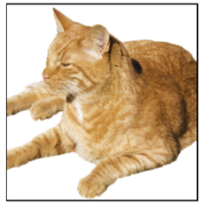
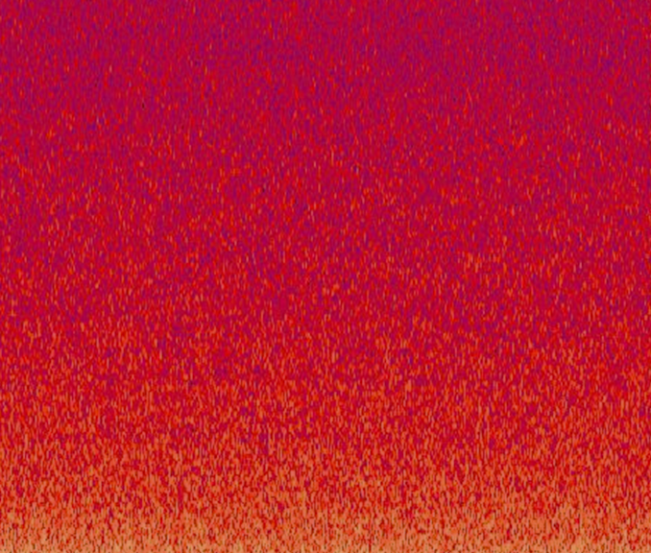
Experiments Setup
300 ms
300 ms
Full-contrast pink noise mask
200 ms
Goal: minimize feedback processing in the human visual system
13 / 26
https://en.wikipedia.org/wiki/Pink_noise#/media/File:Noise.jpg
Notes:
- Minimization of the feedback processing because the CNN is also „just feed-forward“

Slide 16
Experiments Setup
300 ms
300 ms
200 ms
Click at the corresponding category “Guess if unsure“
1500 ms
The categories are known and represented by pictograms
13 / 26
https://en.wikipedia.org/wiki/Pink_noise#/media/File:Noise.jpg

Slide 17
Experiments Setup
300 ms
300 ms
200 ms
1500 ms =1.5 sec!!
airplane | bear | bicycle | bird
boat | bottle | car | cat
chair | clock | dog | elephant
keyboard | knife | oven | truck
= 16-class-ImageNet (Geirhos et al., 2018)
13 / 26
https://en.wikipedia.org/wiki/Pink_noise#/media/File:Noise.jpg

Slide 18
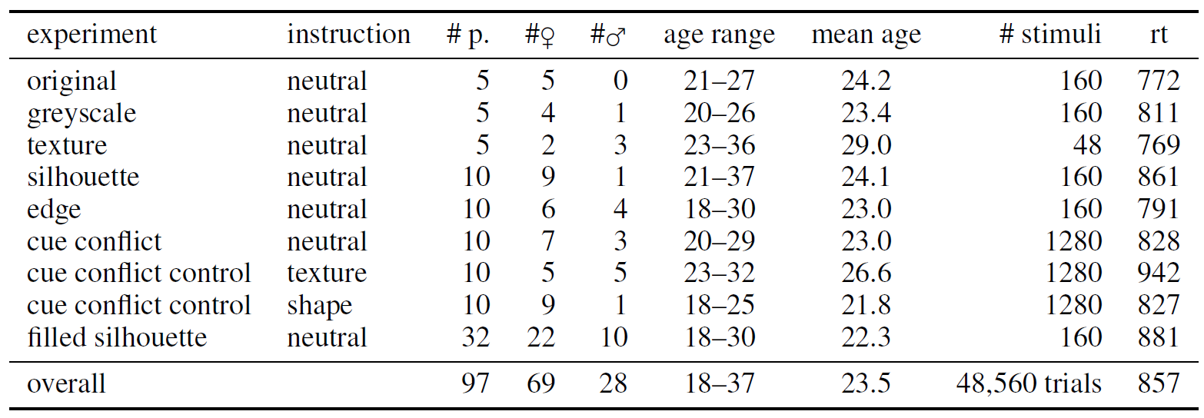
Experiments Setup
TODO
13 / 26

Slide 19
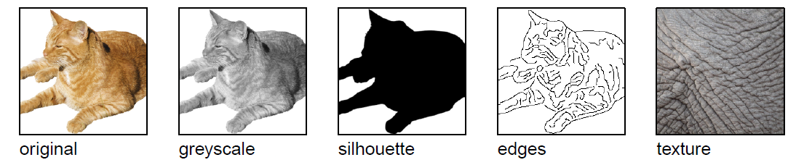
Experiments Setup
TODO
visualize the experimental setup
13 / 26

Slide 20
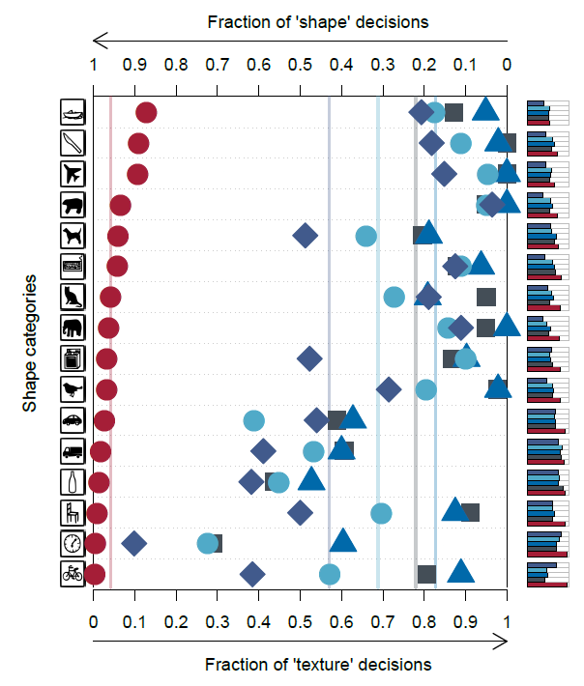
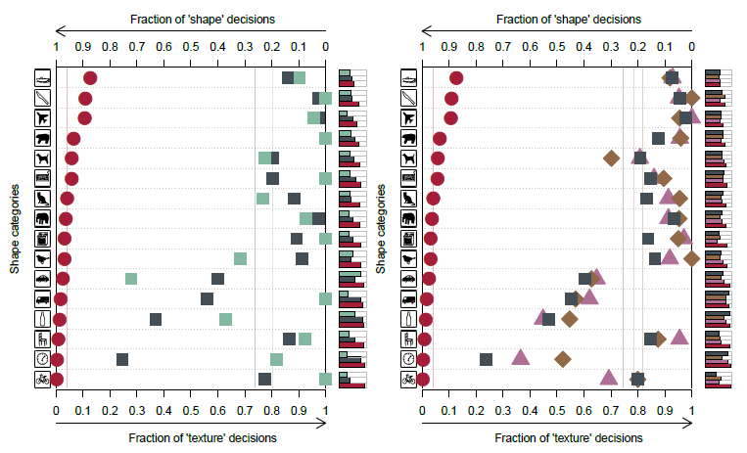
5 Experimental evaluation
TODO: Figure 1, 2, 4
Both good: natural, greyscale, texture
CNN bad: silhouette, edges (= “object shape”) ➔ CNNS difficulties from natural to sketch
26 / 26

Slide 21
Results
The texture hypothesis holds: Classifing objects by textures is easier (but less robust) than classifing them by shape – thus CNNs tend to learn to recognize texture
13 / 26
Notes:
Texture-bias is NOT by design of the CNN
3. ⬅ p.9 Dodge & Karam, 2017, Geiros et. Al. 2017/2018
⬅ as shown there was support given
Entriely „New“ (? Is that so??)

Slide 22
Results
The texture hypothesis holds: CNNs tend to learn to recognize texture rather than shape
13 / 26
Notes:
Texture-bias is NOT by design of the CNN
3. ⬅ p.9 Dodge & Karam, 2017, Geiros et. Al. 2017/2018
⬅ as shown there was support given
Entriely „New“ (? Is that so??)

Slide 23
Results
Idea: SIN
13 / 26
Notes:
Texture-bias is NOT by design of the CNN
3. ⬅ p.9 Dodge & Karam, 2017, Geiros et. Al. 2017/2018
⬅ as shown there was support given
Entriely „New“ (? Is that so??)

Slide 24
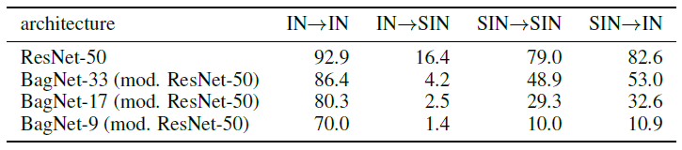
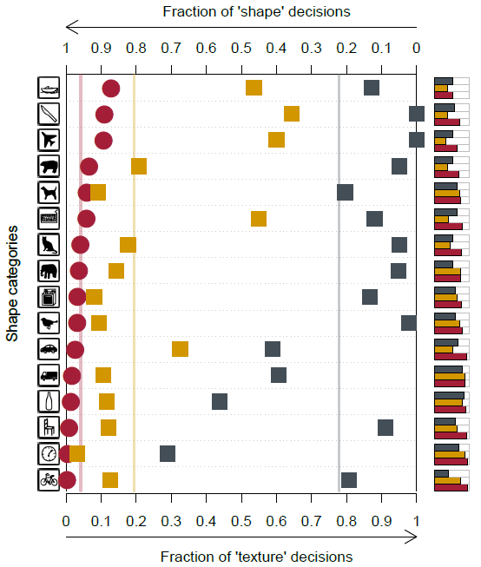
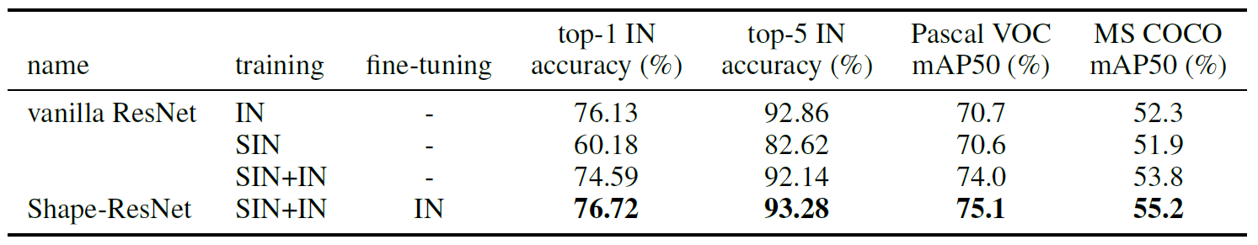
5 Experimental evaluation
TODO: Figure 6,
Table 1 and 2
Texture-shape Cue Conflict: human (shape), CNN (texture) (substantial fraction of difficulties = “hard problem”
26 / 26

Slide 25
Results
The texture hypothesis holds: CNNs tend to learn to recognize texture rather than shape
13 / 26
Notes:
Texture-bias is NOT by design of the CNN
3. ⬅ p.9 Dodge & Karam, 2017, Geiros et. Al. 2017/2018
⬅ as shown there was support given
Entriely „New“ (? Is that so??)

Slide 26
Results
The texture hypothesis holds: Classifing objects by textures is easier (but less robust) than classifing them by shape – thus CNNs tend to learn to recognize texture
The texture-bias of CNNs is induced by the training setup (data) and thus can be cured and changed towards a shape-bias
CNNs trained with a shape-bias are more
robust to distortion
Performant (with respect to classification and object recognition)
13 / 26
Notes:
Texture-bias is NOT by design of the CNN
3. ⬅ p.9 Dodge & Karam, 2017, Geiros et. Al. 2017/2018
⬅ as shown there was support given
Entriely „New“ (? Is that so??)

Slide 27
Conclusion
The texture hypothesis holds: Classifing objects by textures is easier (but less robust) than classifing them by shape – thus CNNs tend to learn to recognize texture
The texture-bias of CNNs is induced by the training setup (data) and thus can be cured and changed towards a shape-bias
CNNs trained with a shape-bias are more
robust to distortion
Performant (with respect to classification and object recognition)
13 / 26
Notes:
Texture-bias is NOT by design of the CNN
3. ⬅ p.9 Dodge & Karam, 2017, Geiros et. Al. 2017/2018
⬅ as shown there was support given
Entriely „New“ (? Is that so??)

Slide 28
Thank you for your attention!

Slide 29
Appendix Other slides

Slide 30
5 Experimental evaluation
26 / 26

Slide 31
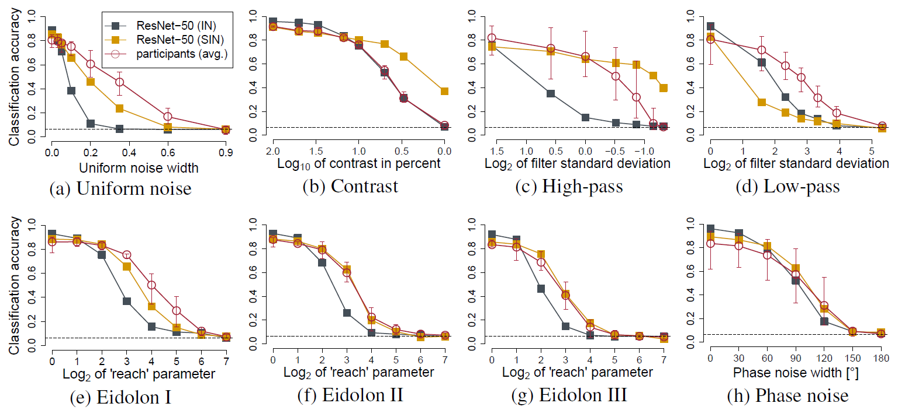
5 Experimental evaluation
26 / 26

Slide 32
Introduction
SHAPE hypothesis: | CNNs learn to recognize and classify shapes
Support: | object parts in high-level CNN features shape bias (shape over colour) (contradicted by Hosseini et al. 2018)
“CNNs are ‘currently’ the most predictive model for human vental stream object recognition”
 | shape is most important cue for humans model for human vental stream computational morel of human shape perception
1 / 26

Slide 33
Introduction
TEXTURE hypothesis: | CNNs learn to recognize and classify textures
Support: | performance: with linear classifier on top of texture representation (Gram matrix) performance: when global shape is destroyed performance: when texture cues are missing performance: with varying object size w.r.t. context performance: static and dynamic texture synthesis performance: varying object dimensions (colour) performance: varying resolution … TODO Gokaslan … TODO performance: constrained receptive field size CNN match texture appearance for humans
Performance: texture-based generative modelling approaches
Performance: shape transfer
1 / 26
Notes:
It is sufficient to use many local texture features (rather than global shapes) for training purpose
-texture-based generative modelling approaches such as style transfer (Gatys et al., 2016), single
image super-resolution (Gondal et al., 2018) as well as static and dynamic texture synthesis (Gatys
et al., 2015; Funke et al., 2017) all produce excellent results using standard CNNs, while CNNbased
shape transfer seems to be very difficult (Gokaslan et al., 2018).

Slide 34
Method
Terminology
DEF: feature = attribute learned by CNN
DEF: cue = physical attribute
Idea: Reduce the the relation of present textures with the solution – for testing and or training (If the performance of the CNNs drops but not the performance of the human, this could indicate that the CNN classify using a different approach. Quantify the texture & shape biases in human & CNN)
Use texture-cure conflics
1 / 26

